Slide 1
Introduction to Quantum Computing: From a Layperson to a Programmer in 30 Steps
Hiu-Yung Wong
https://link.springer.com/book/10.1007/978-3-030-98339-0
https://www.amazon.com/Introduction-Quantum-Computing-Layperson-Programmer/dp/3030983382
Playlist: https://www.youtube.com/watch?v=PY49kYK53cw&list=PLnK6MrIqGXsJfcBdppW3CKJ858zR8P4eP&index=61

Slide 2
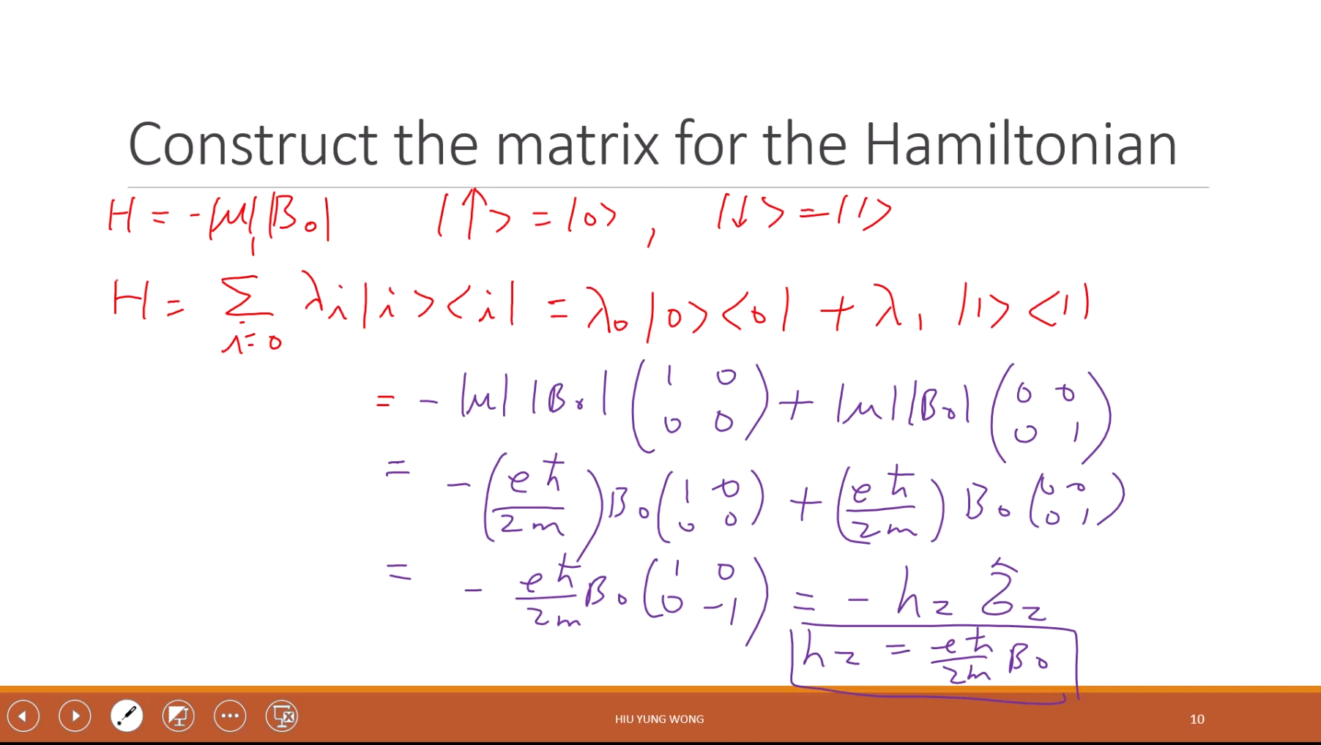
Construct the matrix for the Hamiltonian

Slide 3
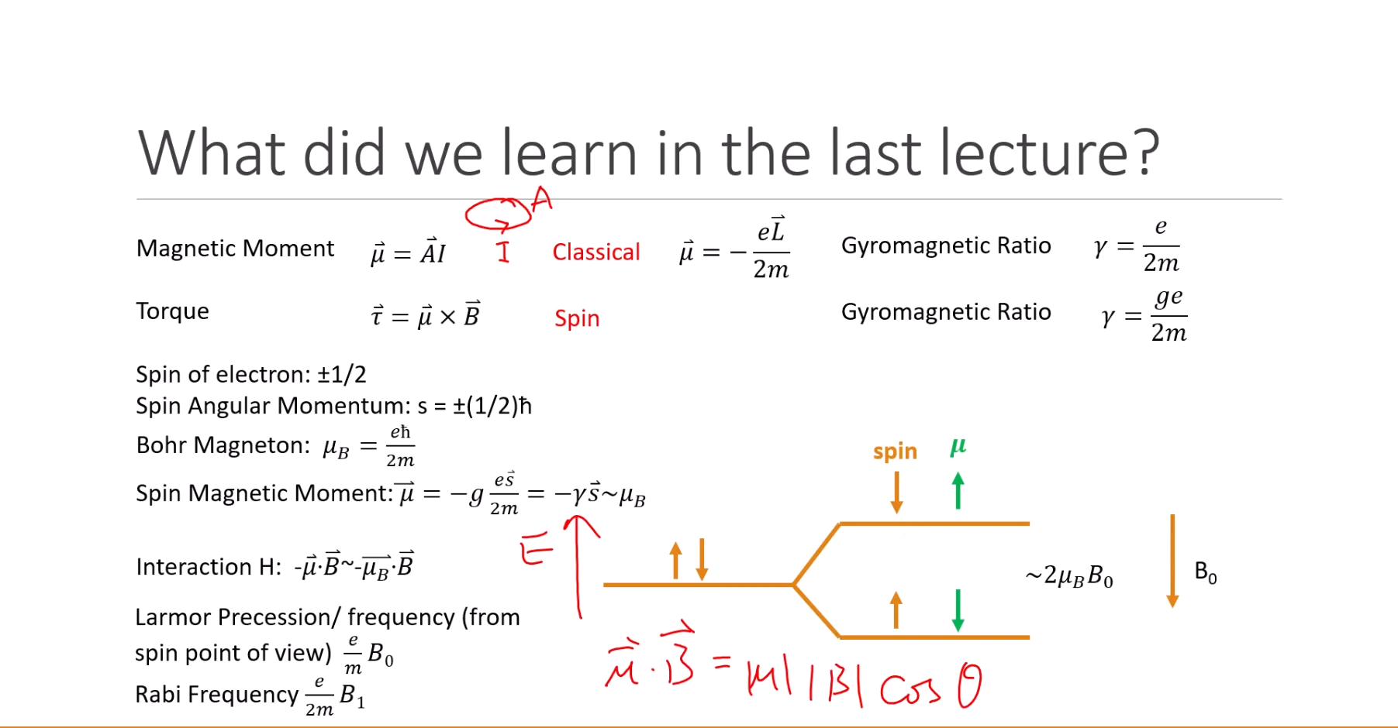

Slide 4
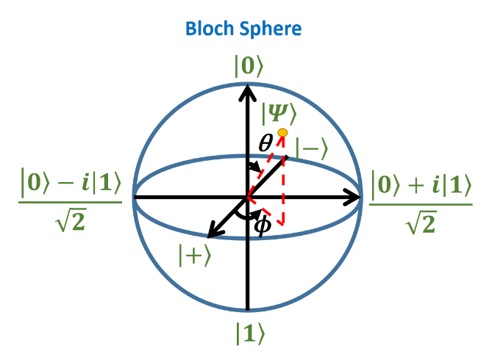
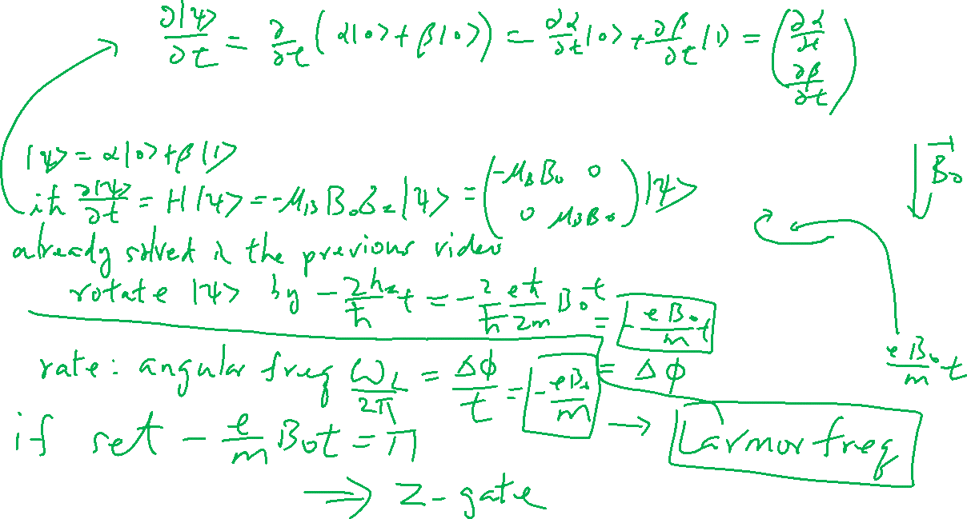
Larmor Precession and Frequency

Slide 5
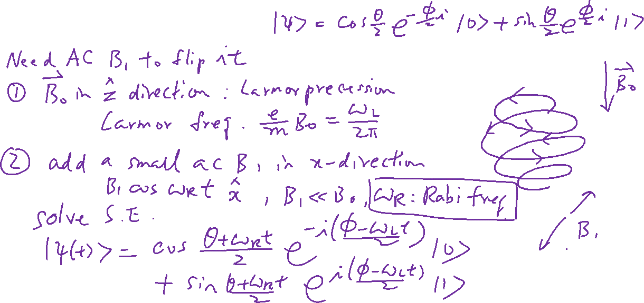
Spin Resonance and Rabi Frequency (To flip the spin)

